Slide 1
Chapter 5
Business Statistics
Math for Business and Finance: an Algebraic Approach, 3rd Edition Jeffrey Slater
© McGraw Hill LLC. All rights reserved. No reproduction or distribution without the prior written consent of McGraw Hill LLC.

Slide 2
Learning Unit Objectives
L U 5-1: Frequency Distributions and Graphs
Prepare a frequency distribution.
Prepare bar, line, and circle graphs.
Calculate price relatives and cost comparisons.
L U 5-2: Mean, Median, and Mode
Define and calculate the mean.
Explain and calculate a weighted mean.
Define and calculate the median.
Define and identify the mode.
L U 5-3: Measures of Dispersion
Explain and calculate the range.
Define and calculate the standard deviation.
Define normal distribution and estimate percentage of data by using standard deviations.

Slide 3
Frequency Distribution
Frequency Distribution - A way of collecting and organizing raw data. Shows the number of data observations that fall into specific intervals.
Computer costs
1000 | 7000 | 4000 | 1000 | 5000 | 1000 | 3000
5000 | 2000 | 3000 | 3000 | 3000 | 8000 | 9000
3000 | 6000 | 6000 | 1000 | 10000 | 1000
Frequency distribution table

Slide 4
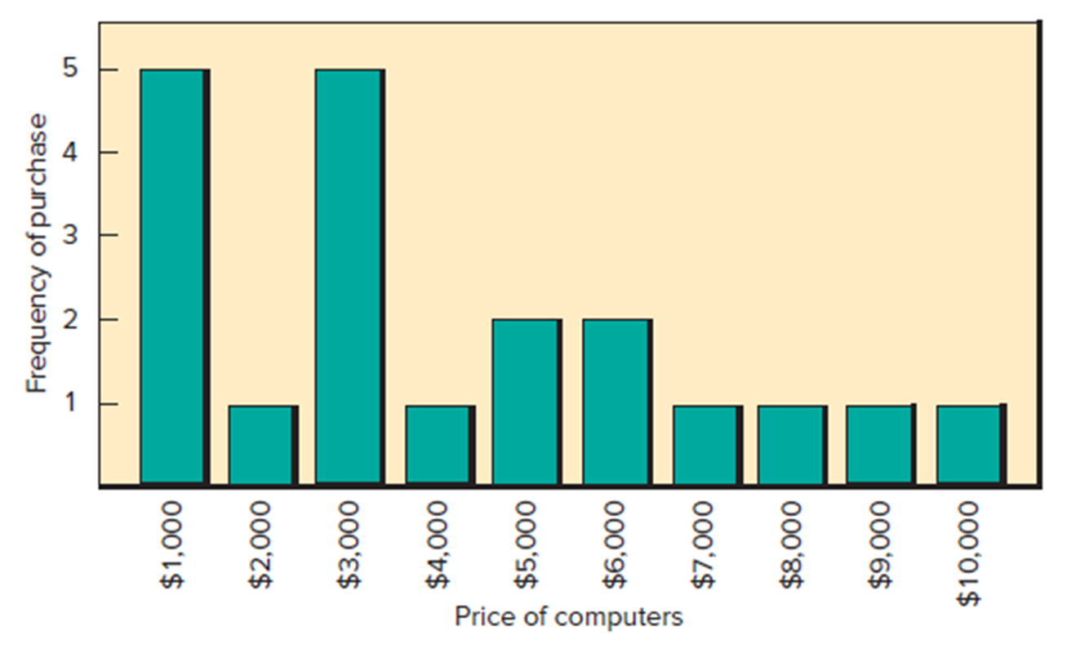
Bar Graph 1
Help readers see changes that have occurred over a period of time.
Access the text alternative for these images

Slide 5
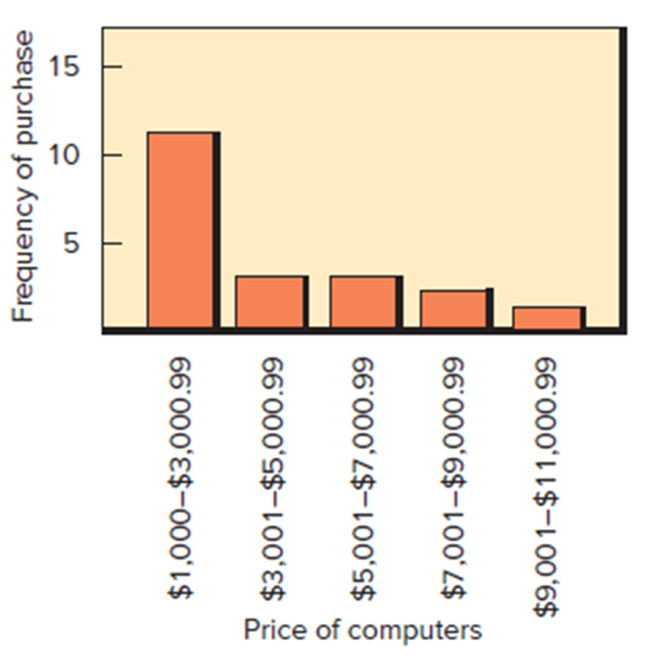
Bar Graph 2
Access the text alternative for these images

Slide 6
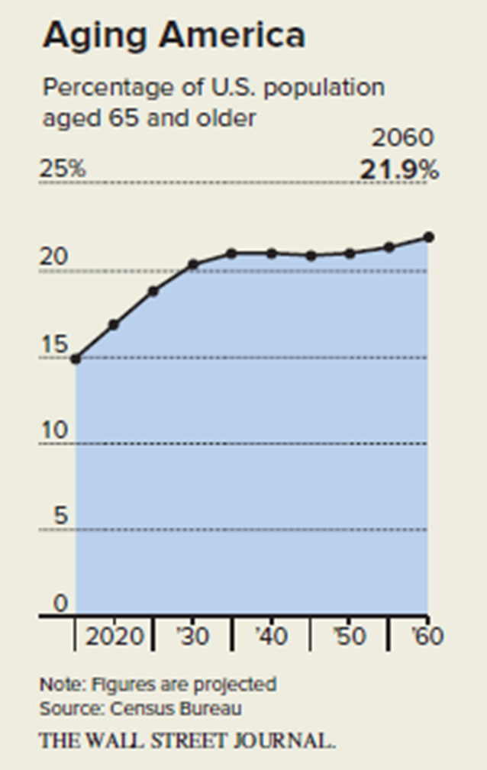
Line Graph
Shows a trend over a period of time.
Access the text alternative for these images

Slide 7
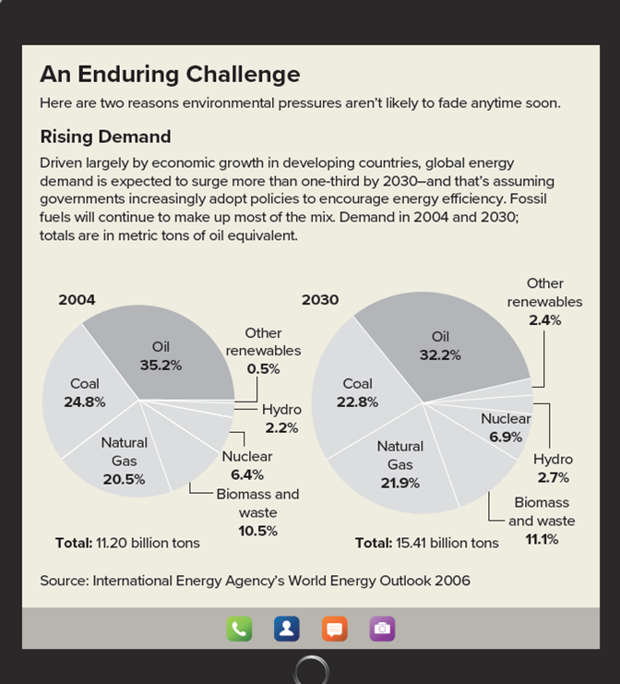
Circle Graph (pie chart)
Helpful in showing the relationship between parts to a whole.
The entire circle represents 100%, or 360°.
Access the text alternative for these images

Slide 8
Index Numbers
Frequently used to make comparisons of a current price relative to a given year.
Also used to estimate current prices at various geographic locations.
Example:
A calculator may cost $9 today relative to a cost of $75 some 30 years ago. What is the relative price?

Slide 9
Terminology
Mean – An arithmetic average found by adding all of the data and dividing by the number of values.
Median - A measurement that indicates the center of the data.
Mode - The value that occurs most often.

Slide 10
Mean
Example:
The accountant of Bill’s Sport Shop told Bill, the owner, that the average daily sales for the week were $150.14. The accountant stressed that $150.14 was an average and did not represent specific daily sales. Bill wanted to know how the accountant arrived at $150.14.
Sun. | Mon. | Tues. | Wed. | Thur. | Fri. | Sat.
$400 | $100 | $68 | $115 | $120 | $68 | $180

Slide 11
Finding the Median of a Group of Values 1
Example:
Look below at the following yearly salaries of the employees of Rusty’s Clothing Shop.
Alice Knight | $95,000 | Jane Wang | $67,000
Jane Hess | $27,000 | Bill Joy | $40,000
Joel Floyd | $32,000
Find the mean value of all employees.
Solution:

Slide 12
Weighted Mean
The format for the weighted mean is slightly different from that for the mean. The concept, however, is the same except that you weight each value by how often it occurs (its frequency).
Example:
How Jill Rivers calculated her G P A to the nearest tenth given A = 4.0, B = 3.0, C = 2.0, D = 1.0 and F = 0:
Courses | Credit Attempted | Grade Received | Points (Credits × Grade)
Intro to Comp. | 4 | A | 16 (4 × 4)
Psychology | 3 | B | 9 (3 × 3)
English Comp. | 3 | B | 9 (3 × 3)
Business Law | 3 | C | 6 (2 × 3)
Business Math | 3 | B | 9 (3 × 3)
 | 16 |  | 49
Solution:

Slide 13


Finding the Median of a Group of Values 2
2 Steps
Arrange values from the smallest to the largest.
95, 27, 32, 67, 40
Find the middle value.
27, 32, 40 , 67, 95
Median = 40
a. Odd number of values: Median is the middle value.
b. Even number of values: Median is the average of the two middle values.
95, 32, 67, 40
Ordered: 32, 40, 67, 95

Slide 14
Mode
Mode is the value that occurs most often.
If two or more numbers appear most often, you may have two or more modes.
If all the values are different, there is no mode.
Example:
Find the mode of the following data:
3, 4, 5, 6, 3, 8, 9, 3, 5, 3
Solution:
3 is the mode since it is listed 4 times.

Slide 15
Measure of Dispersion
Measure of Dispersion – A number that describes how the numbers of a set of data are spread out or dispersed. Range and standard deviation are measures of dispersion.
Range – The difference between the two extreme values (highest and lowest) in a group of values or a set of data.
Range = Highest value − Lowest value
Example:
Find the range of the following values:
83.6, 77.3, 69.2, 93.1, 85.4, 71.6
Range = 93.1 − 69.2 = 23.9

Slide 16
Variance and Standard Deviation
Standard deviation is intended to measure the spread of data around the mean.
6 Steps
Find the mean of the set of data.
Subtract the mean from each data point to find each deviation.
Square each deviation (multiply the deviation by itself).
Sum all squared deviations (add them together).
Divide the sum of the squared deviations by n − 1, where n equals the number of data points. This is the variance.
To calculate the standard deviation, find the square root of the number obtained in Step 5 (Use calculator). This is the standard deviation. (the square root is a number that when multiplied by itself equals the amount shown inside the square root symbol).

Slide 17
Calculating the Variance and Standard Deviation
Sample variance
Sample standard deviation

Slide 18
Standard Deviation 1
Data set A | Data set B

Slide 19
Standard Deviation 2
Data sets A and B have equal means, but different standard deviations.
Step 5: Divide by n − 1:
Step 5: Divide by n − 1:
Step 6: The square root of
Step 6: The square root of
is 4.8 (rounded).
The standard deviation of data set A is 4.8.
The standard deviation of data set B is 2.3.

Slide 20
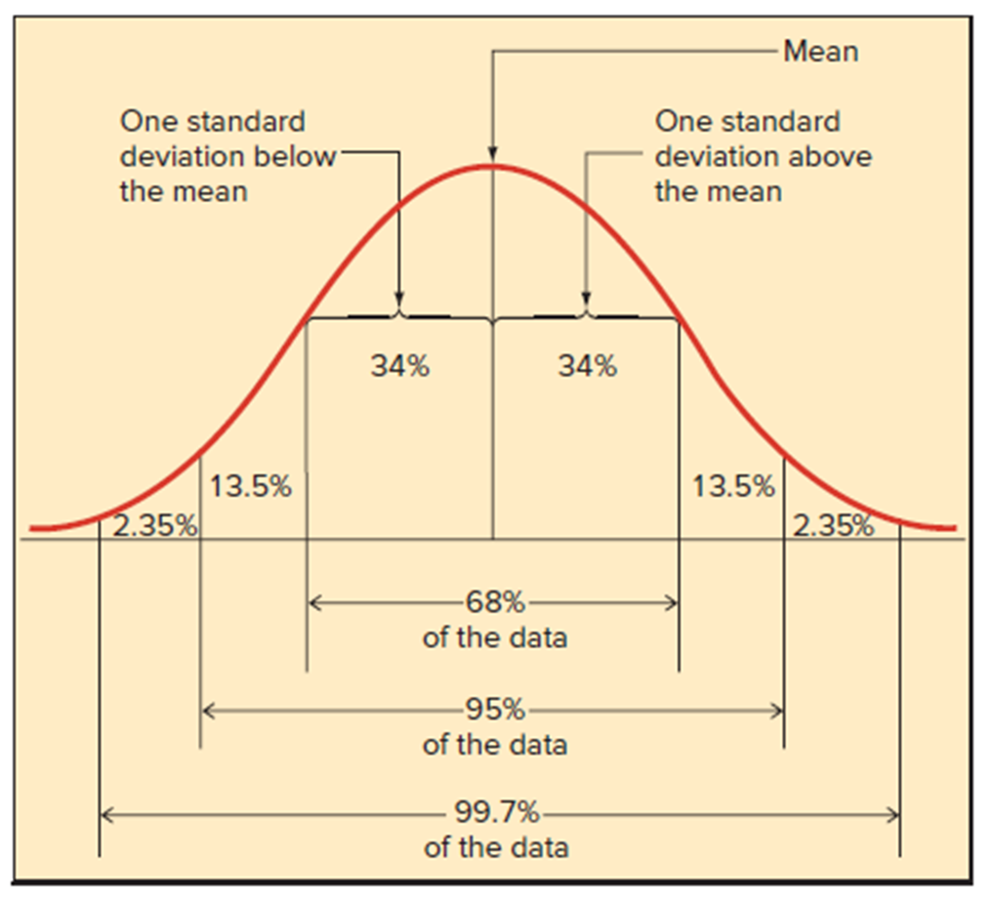
Normal Distribution (Figure 5.1)
Access the text alternative for these images

Slide 21
Normal Distribution (2)
In a normal distribution, the mean, median, and mode are all equal.
Additionally, when the data are normally distributed, the Empirical Rule (Three Sigma Rule) applies, stating that for a normal distribution, also known as a bell curve, approximately:
68% of the observations will fall within ± 1 standard deviation of the mean,
95% will fall within ± 2 standard deviations of the mean, and
99.7% will fall within ± 3 standard deviations of the mean.

Slide 22
Applying the Normal Distribution
5 Steps
Calculate the mean.
Calculate the standard deviation.
Determine the number of standard deviations of the mean.
Add and subtract the number of standard deviations to and from the mean.
The resulting two values are the range of your data.

Slide 23
Textbook Problem 5-1
Problem Statement:
Calculate the mean (to the nearest hundredth): L U 5-2(1)
7, 8, 6, 10
Solution:

Slide 24
Textbook Problem 5-8
Problem Statement:
Find the median: L U 5-2(3)
55, 10, 19, 38, 100, 25
Solution:
10, 19, 25, 38, 55, 100

Slide 25
Textbook Problem 5-11
Problem Statement:
Find the mode: L U 5-2(4)
22, 19, 15, 16, 18, 18, 5, 18
Solution:
= 18

Slide 26
Textbook Problem 5-12
Problem Statement:
Given:
Truck cost | 2023 | $60,000
Truck cost | 2008 | $21,000
Calculate the price relative (rounded to the nearest tenth percent): L U 5-1(3)
Solution:

Slide 27
Textbook Problem 5-16
Problem Statement:
How many degrees on a pie chart would each be given from the following? L U 5-1(2)
Wear digital watch | 42%
Wear traditional watch | 51%
Wear no watch | 7%
Solution:
.42 × 360° = | 151.2°
.51 × 360° = | 183.6°
.07 × 360° = | 25.2°
 | 360°

Slide 28
Textbook Problem 5-18
Problem Statement:
Calculate the variance and standard deviation for the following sample set of data.
Round the final answer to the nearest tenth. L U 5 − 3(2)
83.6, 92.3, 56.5, 43.8, 77.1, 66.7
Solution:
Variance:
Standard deviation:

Slide 29
End of Main Content
© McGraw Hill LLC. All rights reserved. No reproduction or distribution without the prior written consent of McGraw Hill LLC.

Slide 30
Accessibility Content: Text Alternatives for Images

Slide 31
Bar Graph 1 – Text Alternative
Return to parent-slide containing images.
The column chart represents the frequency of purchase on the vertical axis which ranges between 1 and 5 in increments of 1 unit and the price of computers on the horizontal axis which ranges between 1000 and 10000 dollars in increments of 1000 dollars. The estimated values are as follows. (1000 dollars, 5), (2000 dollars, 1), (3000 dollars, 5), (4000 dollars, 1), (5000 dollars, 2), (6000 dollars, 2), (7000 dollars, 1), (8000 dollars, 1), (9000 dollars, 1), (10000 dollars, 1).
Return to parent-slide containing images.

Slide 32
Bar Graph 2 – Text Alternative
Return to parent-slide containing images.
The column chart represents frequency of purchase on the vertical axis, which ranges between 5 and 15 in increments of 5, and the price of computers on the horizontal axis, which ranges between 1,000 and 12,000 dollars. The estimated values are as follows. ($1,000 to $3,000.99, 12), ($3,001 to $5,000.99, 3), ($5,001 to $7,000.99, 3), ($7,001 to $9,000.99, 2), and ($9,001 to $11,000.99, 1).
Return to parent-slide containing images.

Slide 33
Line Graph – Text Alternative
Return to parent-slide containing images.
The graph represents the percentage of the U.S. population aged 65 and older on the vertical axis that ranges between 0 and 25 in increments of 5 percent and year on the horizontal axis from 2020 to 2060. The estimated values are as follows. (2020, 17%), (2025, 18%), (2030, 20%), (2035, 20.5%), (2040, 21%), (2045, 20.9%), (2050, 21%), (2055, 21.3%), (2060, 21.9%).
Return to parent-slide containing images.

Slide 34
Circle Graph (pie chart) – Text Alternative
Return to parent-slide containing images.
An enduring challenge: Here are two reasons environmental pressures aren’t likely to fade anytime soon. Rising Demand: Driven largely by economic growth in developing countries, global energy demand is expected to surge more than one-third by 2030—and that's assuming governments increasingly adopt policies to encourage energy efficiency. Fossil fuels will continue to make up most of the mix. Demand in 2004 and 2030; totals are in metric tons of oil equivalent. Two pie graphs are titled 2004 and 2030. In 2004, the total is indicated as 11.20 billion tons. The data of the graph are shown as follows: Oil, 35.2 percent. Other renewables, 0.5 percent. Hydro, 2.2 percent. Nuclear, 6.4 percent. Biomass and waste, 10.5 percent. Natural gas, 20.5 percent. Coal, 24.8 percent. In 2030, the total is indicated as 15.41 billion tons. The data of the graph are shown as follows: Oil, 32.2 percent. Other renewables, 2.4 percent. Hydro, 2.7 percent. Nuclear, 6.9 percent. Biomass and waste, 11.1 percent. Natural gas, 21.9 percent. Coal, 22.8 percent. Source: International Energy Agency’s World Energy Outlook 2006. Call, contacts, message, and camera icons are at the bottom.
Return to parent-slide containing images.

Slide 35
Normal Distribution (Figure 5.1) – Text Alternative
Return to parent-slide containing images.
The mean is at the center of the curve. 68% of data falls within one standard deviation of the mean, 95% of the data falls within two standard deviations of the mean, and 99.7% of data falls within three standard deviations of the mean.
Return to parent-slide containing images.

